Slide 1

A View from the State DOTs
Joung H. Lee
Associate Director for Finance and Business Development
American Association of State Highway and Transportation Officials
Deputy Director
AASHTO Center for Excellence in Project Finance

Slide 2
SESSION OBJECTIVES
To provide an update on state spending levels
To discuss the state of current surface transportation funding, including Federal Highway Trust Fund conditions
To examine overall surface transportation investment needs
To provide AASHTO’s funding framework for the future

Slide 3

STATE SPENDING PICTURE

Slide 4
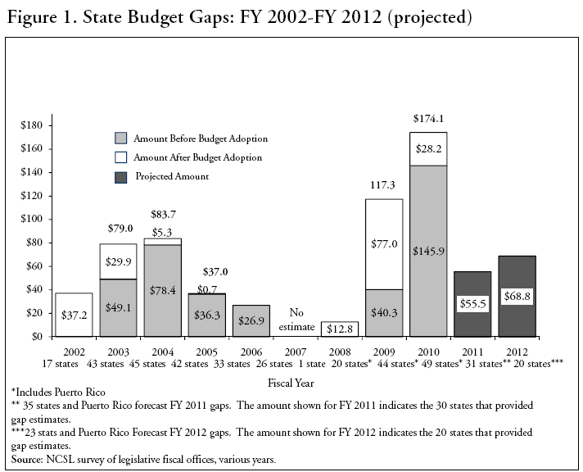

Slide 5
NCSL Projected State Budget Gaps
As of July 2010:
  $83.9 billion in FY 2011
  $72.1 billion in FY 2012
  $64.3 billion in FY 2013

Slide 6
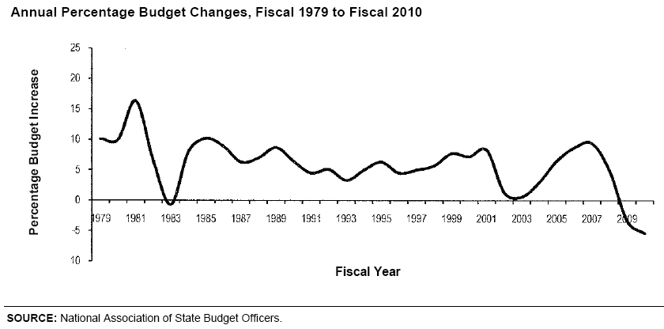

Slide 7
Transportation Spending Cuts in 21 States in FY 2010
Arizona
California
Connecticut
Florida
Georgia
Kansas
Louisiana
Massachusetts
Maine
Michigan
Mississippi
Nevada
North Carolina
New Jersey
New York
Ohio
Pennsylvania
South Carolina
Virginia
Washington
Wisconsin
Source: National Association of State Budget Officers

Slide 8

CURRENT TRENDS
AND CHALLENGES

Slide 10
Truck, Buses, and Trailer Retail Tax Receipts
(1957-2009)

Slide 12
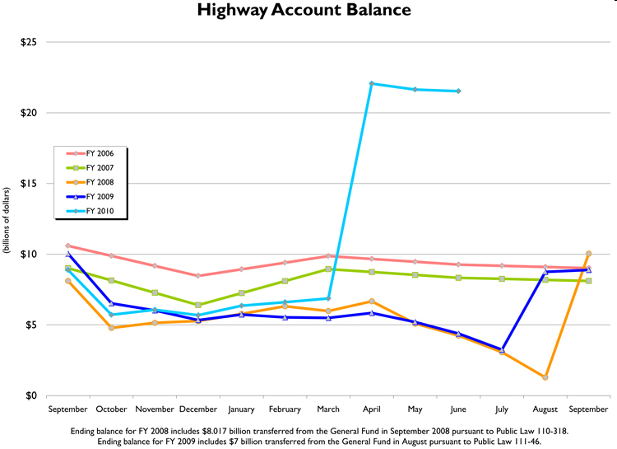
Source: Federal Highway Administration
Notes:
Ensuring Highway Trust Fund Stability
What’s clear from this chart is that the cash balance trajectory for this year is much worse than in the prior years.
We will continue to closely monitor this situation

Slide 13
Purchasing Power Loss of the
Highway Program
Source: Transportation Weekly

Slide 14
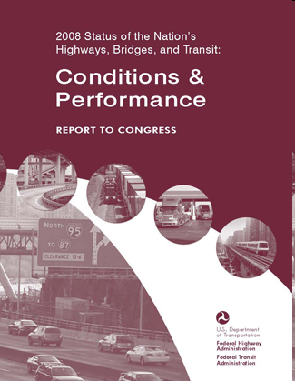
2008 Conditions and Performance Report

Slide 15
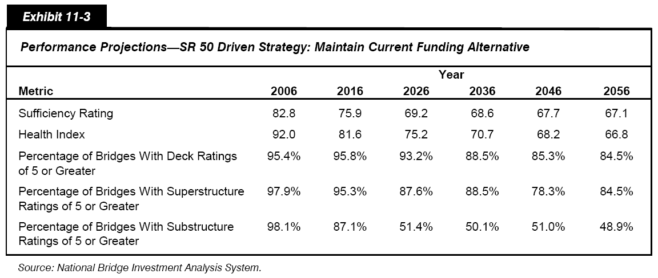
Bridge Conditions at Current Funding

Slide 16
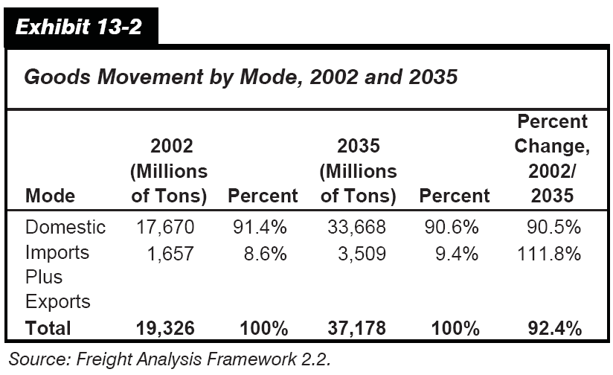
Goods Movement Projections

Slide 17
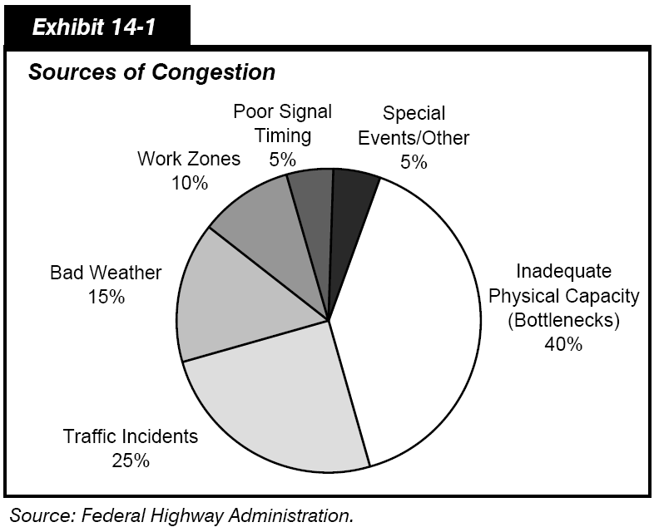
Tackling Congestion

Slide 18
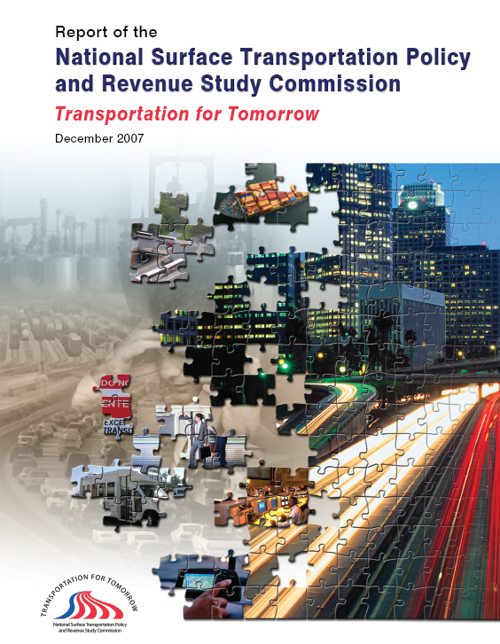
NATIONAL SURFACE TRANSPORTATION
POLICY AND REVENUE STUDY COMMISSION
Notes:
18

Slide 19
Needs
We need to spend $225 to $340 billion per year on average through 2055
  Highway
  Bridge
  Public transit
  Freight rail
  Intercity passenger rail
Currently spending is less than $90 billion per year

Slide 20
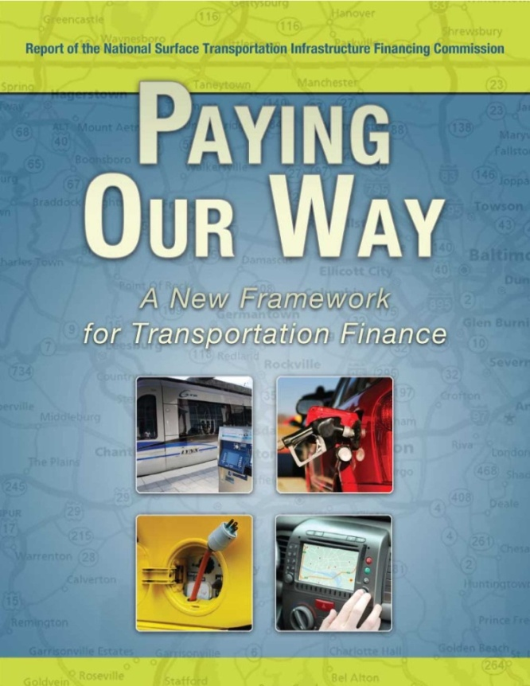
NATIONAL SURFACE TRANSPORTATION INFRASTRUCTURE FINANCING COMMISSION
Notes:
20

Slide 21
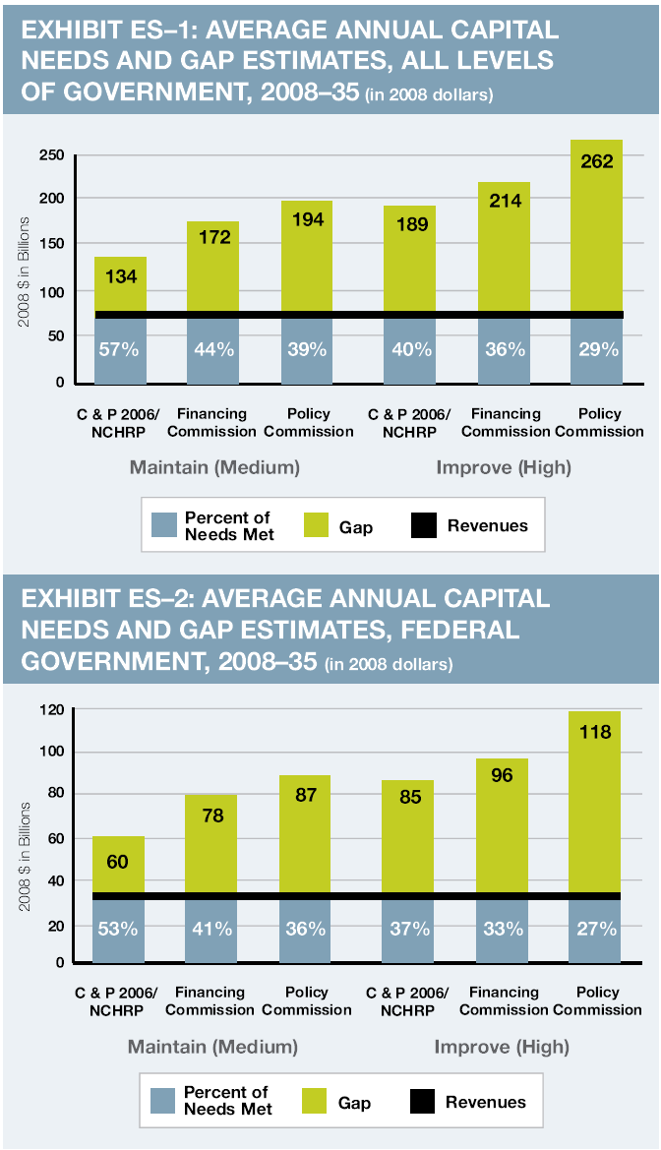
Needs
  Nationally, meeting only about 1/3 of roughly $200 billion required each year to maintain and improve the system
  At federal level, also meeting only about 1/3 of needs – we face a $400 billion federal funding gap over next 6 years under current policies and revenues

Slide 22
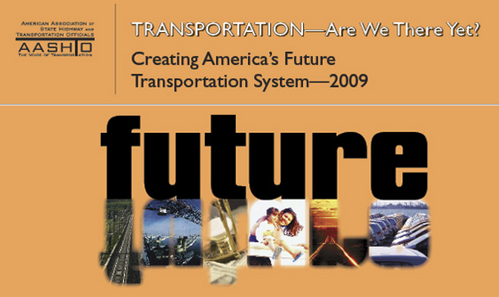
AASHTO’s Vastly Expanded
Funding Proposal
Notes:
22

Slide 23
Legislative Recommendations
Between 2010 and 2015, in order to invest in a robust surface transportation program to meet significant national needs, Congress should fund a $565 billion multimodal program comprised of:
  Highway program funded at $375 billion (2015 level = $75 billion)
  Transit program funded at $100 billion (2015 level = $20.8 billion)
  Freight program funded at $40 billion (2015 level = $9.2 billion)
  Intercity passenger rail program funded at $50 billion (2015 level = $11.7 billion)

Slide 24
Legislative Recommendations
Federal government must continue to play a strong role in investing and maintaining an integrated and multimodal national surface transportation system
States and local governments should be provided with maximum flexibility to use federal revenues from existing core sources to meet systemic transportation needs
Strong accountability measures must accompany substantially increased funding to ensure resources are spent as efficiently and effectively as possible
We need to restore purchasing power by making sure the impact of inflation on commodities and construction costs must be addressed in setting investment levels
24
Notes:
24

Slide 25
Legislative Recommendations
Adopt a long-range approach to funding the surface transportation system that gradually moves away from dependence on the current motor fuels tax to a distance-based direct user fee such as a fee on vehicle miles traveled
Assure that any climate change legislation that creates a new revenue source, either through a carbon tax or cap-and-trade, provides substantial funding for transportation
Eliminate or drastically limit earmarking in federal transportation programs
25
Notes:
25
Given the magnitude and diversity of needs, states and local governments should be provided with maximum flexibility to use federal revenues from existing core sources to meet systemic transportation needs.

Slide 26
Proposed Program Funding Levels to Restore Purchasing Power
Notes:
26
Let me just close by summarizing AASHTO’s funding proposals. Discuss.

Slide 27
Notes:
27
Other revenue options.

Slide 28
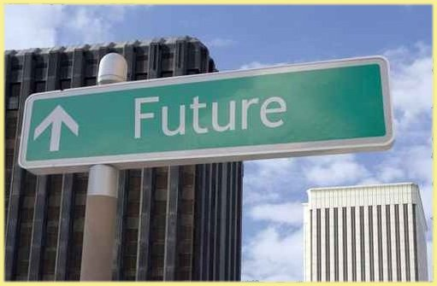
Surface Transportation
Authorization

Slide 29
Surface Transportation
Authorization Act of 2009
Funding
Total funding $450 billion; a$500 billion with High Speed Rail
$337.4 billion in Highway investment
  $100 billion for Capital Asset Improvement (NHS, IM, Bridge)
  $50 billion for Metropolitan Mobility and Access (MMA)
  $25 billion for Projects of National Significance
  $162.4 billion for other FHWA-administered programs (e.g. Highway Safety Improvement, Surface Transportation, CMAQ, Freight, etc)
$99.8 billion transit
  $87.6 billion from HTF
  HTF share was 15.2% in SAFETEA-LU; it is increased to 19.5% in STAA
  $12.2 billion from GF
$50 billion high speed rail corridors
$12.6 billion Motor Carrier Safety

Slide 30
Surface Transportation
Authorization Act of 2009
Specific authorizations are not included in the bill nor are the apportionment formulas
While the top line numbers are in the bill there is no specific breakdown by category and no formulas or runs that would show state shares or return on contributions
There is no revenue title to be bill yet

Slide 31
Where We Are Now
15 September 2008: $8.017 billion General Fund transfer to the Highway Trust Fund
7 August 2009: $7 billion General Fund transfer to the Highway Trust Fund
30 September 2009: SAFETEA-LU expired
1 March 2010: Highway Trust Fund shutdown for two days
18 March 2010: $19.5 billion General Fund transfer to the Highway Trust Fund
31 December 2010: Current SAFETEA-LU extension expires
Fiscal Year 2012: Highway Trust Fund projected to become insolvent

Slide 32
Thank You
Joung H. Lee
Associate Director for Finance and Business Development
AASHTO - American Association of State Highway and Transportation Officials
444 North Capitol Street NW, Suite 249
Washington, DC 20001
Phone: (202) 624-5818
Fax: (202) 624-5469
Email: jlee@aashto.org
Web: www.transportation.org

